Slide 1
Super Stealth Chat
Nathan Tiegiser Jonas Metzger

Slide 2
What is Super Stealth Chat?
A chatting service where security is the top concern
No dedicated server
No accounts, just usernames
End-to-end encryption

Slide 3
Room Creation
Host makes a room with a password
Hash password to get room key
SHA-256
480,000 rounds
Length 32 (in base64)
Hashed password is used as an AES key

Slide 4
Joining a Room
User enters in a username, room url, and room password
A request is made to host at the room url with the users username, public key, proxy url, and the password all encrypted with the hashed password (AES)
On success, host will respond with all usernames and corresponding public keys (RSA)

Slide 5
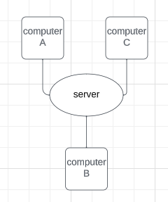
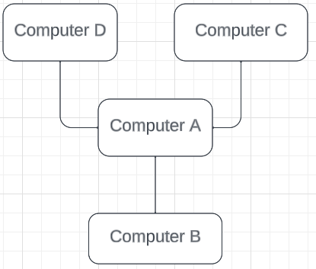
Room Setup
Host ~ non-dedicated server and a “reverse proxy” sits in front of each computer
Normal setup
Super Stealth Chat setup

Slide 6
Message/Image Distribution
(For user) User encrypts message with each users public key and sends this payload to the host.
(For user) Host receives payload and redirect each piece of the payload to corresponding users.
(For host) Host encrypts message with each public key and directly sends each encrypted text to each user.

Slide 7
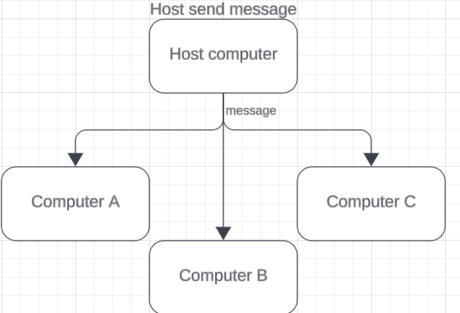
Host sends message

Slide 8
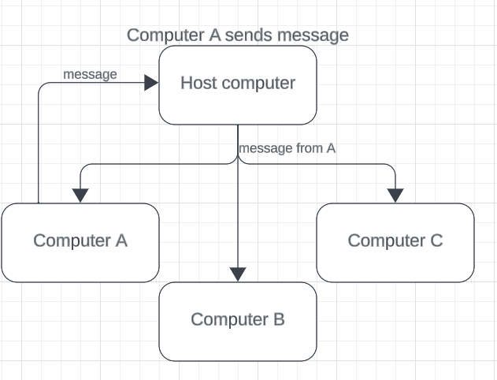
User Sends Message

Slide 9
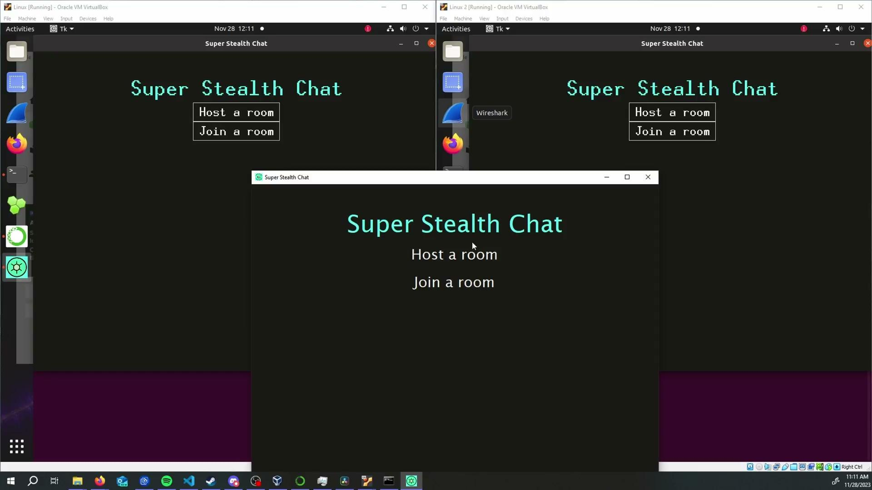
Demo Time! (Video does not work, video file is location at “video resources/prez_Demo.mov”)

Slide 10
Drawbacks
RSA is a little slow
Having to encrypt each message/image multiple times (for each users public key) takes time
RSA is mostly only good for encrypting small plaintexts, not great for images
AES key is based a user created password, bad ones could be guessed

